Slide 1
Introduction To Software Testing

Slide 2
Software Testing
Software testing is the process of evaluating and verifying that a software product or application does what it is supposed to do.
The benefits of testing include preventing bugs, reducing development costs and improving performance.

Slide 3
Software Testing - Methods
Black Box Testing
White-Box Testing
Grey-Box Testing

Slide 4
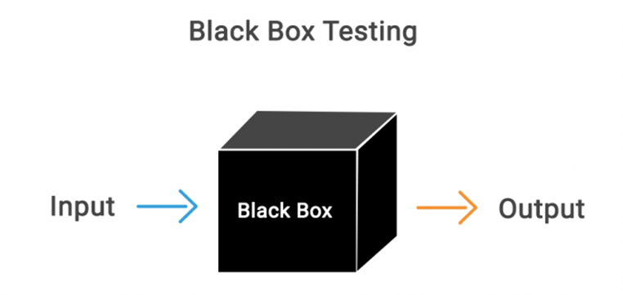
Black-Box Testing
Black Box Testing is a software testing method in which the functionalities of software applications are tested without having knowledge of internal code structure, implementation details and internal paths.

Slide 5
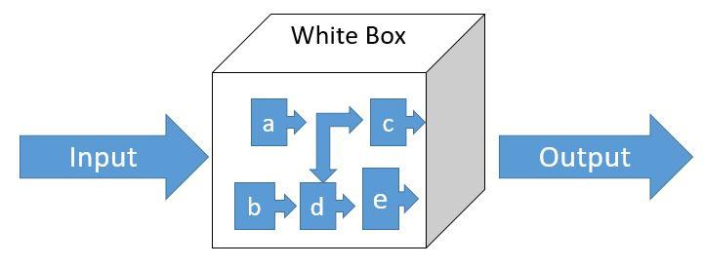
White-Box Testing
White-box testing is the detailed investigation of internal logic and structure of the code. White-box testing is also called glass testing or open-box testing.
In order to perform white-box testing on an application, a tester needs to know the internal workings of the code.

Slide 6
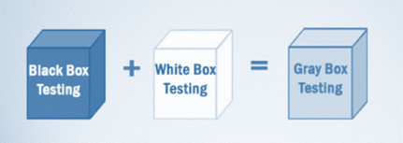
Grey-Box Testing
Grey-box testing is a technique to test the application with having a limited knowledge of the internal workings of an application.

Slide 7
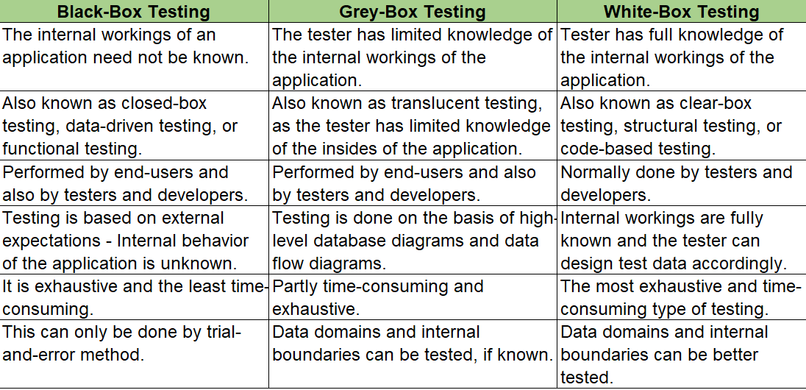
Comparison of Testing Methods

Slide 8
Software Testing - Levels
The main levels of software testing are:
Functional Testing
Non-functional Testing

Slide 9
Functional Testing
Functional testing is a type of testing that seeks to establish whether each application feature works as per the software requirements.
Each function is compared to the corresponding requirement to ascertain whether its output is consistent with the end user's expectations.

Slide 10
Functional Testing…
Unit Testing
Integration Testing
Interface Testing
System Testing
Regression Testing
Smoke Testing
Sanity Testing
Acceptance Testing

Slide 11
Functional Testing…
Unit Testing:
Smallest functional and testable unit of code is tested during unit testing.
Performed during the earliest stages of development, hence helps in uncovering defects during initial development phases. This helps in saving the higher cost of fixing the defects during the later stages of the STLC.
Integration Testing:
Two or more unit tested components of the software are integrated together, and tested to validate the interaction between them is as expected.
Interface Testing:
A part of integration testing; the correctness of data exchange, data transfer, messages, calls and commands between two integrated components are tested.

Slide 12
Functional Testing…
System Testing:
All components of the system are combined and the system is tested for compliance and correctness against the requirement specifications (Functional or System).
It is a Black-Box testing technique which validates the integrated system.
Regression Testing:
After some enhancements or code fixes by developers, it becomes very important to run the regression test suite.
Regression is run to ensure that these code changes have not hampered the existing working functionalities or any new defect is not injected in the code.
Smoke Testing:
After development, when a new build is released, Smoke Testing is performed on the application to ensure that all end-to-end major functionalities work.

Slide 13
Functional Testing…
Sanity Testing:
Sanity Testing is done on the new build created by developers for a relatively stable application.
Acceptance Testing:
During Acceptance Testing, the acceptance of the application by the end-user is tested.
Aim of this testing is to make sure that the developed system fulfils all the requirements that were agreed upon during the business requirement creation.

Slide 14
Non-Functional Testing
Non-functional testing is defined as a type of Software testing to check non-functional aspects (performance, usability, reliability, etc) of a software application.

Slide 15
Non-Functional Testing…
Performance Testing
Load Testing
Stress Testing
Usability Testing
Security Testing
Volume Testing

Slide 16
Non-Functional Testing…
Performance Testing:
Performance testing examines the speed, stability, reliability, scalability, and resource usage of a software application under a specified workload.
Load Testing:
This type of software testing process determines how the software application behaves while being accessed by multiple users simultaneously.
Stress Testing:
Stress testing is a software testing activity that tests beyond normal operational capacity to test the results.

Slide 17
Non-Functional Testing…
Usability Testing:
The application flow is tested to see if a new user can understand the application easily or not. Proper help is documented if a user gets stuck at any point. Basically, system navigation is checked in this testing.
Security Testing:
Security testing unveils the vulnerabilities of the system to ensure that the software system and application are free from any threats or risks.
These tests aim to find any potential flaws and weaknesses in the software system that could lead to a loss of data, revenue, or reputation per employees or outsides of a company.

Slide 18
Non-Functional Testing…
Volume Testing:
The software or application undergoes a huge amount of data and Volume Testing checks the system behavior and response time of the application when the system came across such a high volume of data.
This high volume of data may impact the system’s performance and speed of processing time.

Slide 19

Example
Write test cases for traffic signal:
let’s first understand the lights.
Red – stop and wait before the zebra crossing line.
Green – go.
Yellow – stop,
unless – 1) you’ve already crossed the stop line after green light is off.
2) you’re so close to it that pulling up might cause an accident. 3) You’re in middle of the road and should move to next side rather than going back causing traffic problem.

Slide 20
Here are the list of test cases for traffic signal
Check if the traffic lights are on during the expected traffic period as per rules.
Check if the traffic lights timer works as per expected specific signal.
Check if the traffic lights are displayed in sequential order.
Check if the traffic light for stop signal is shown with red light.
Check if the traffic light for wait unless signal is shown with yellow or amber color.
Check if the traffic light for go is shown with green.
Check if the traffic lights are one at a time.
Check if the traffic lights during off hours show blinking yellow or amber color displaying off for rules.
Check the time delay between the lights.
Check the sequence of multiple signal posts are in sync in cross roads.

Slide 21
Why software testing is important
Architectural flaws
Poor design decisions
Invalid or incorrect functionality
Security vulnerabilities
Scalability issues

Slide 22

Questions?

Slide 23
Thank you

